Slide 1
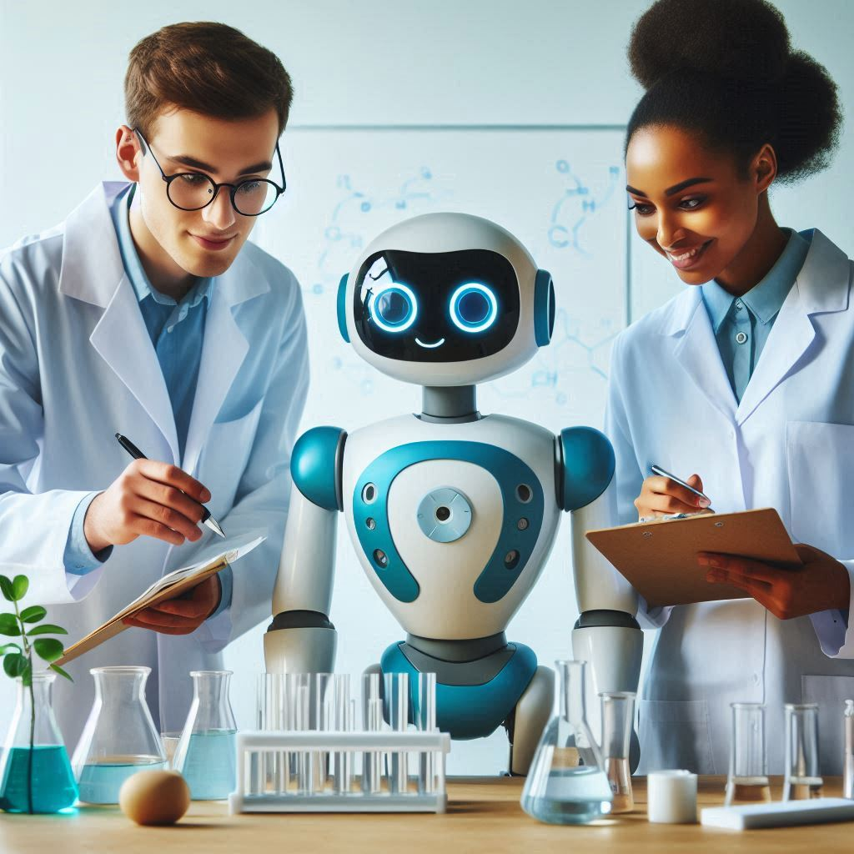
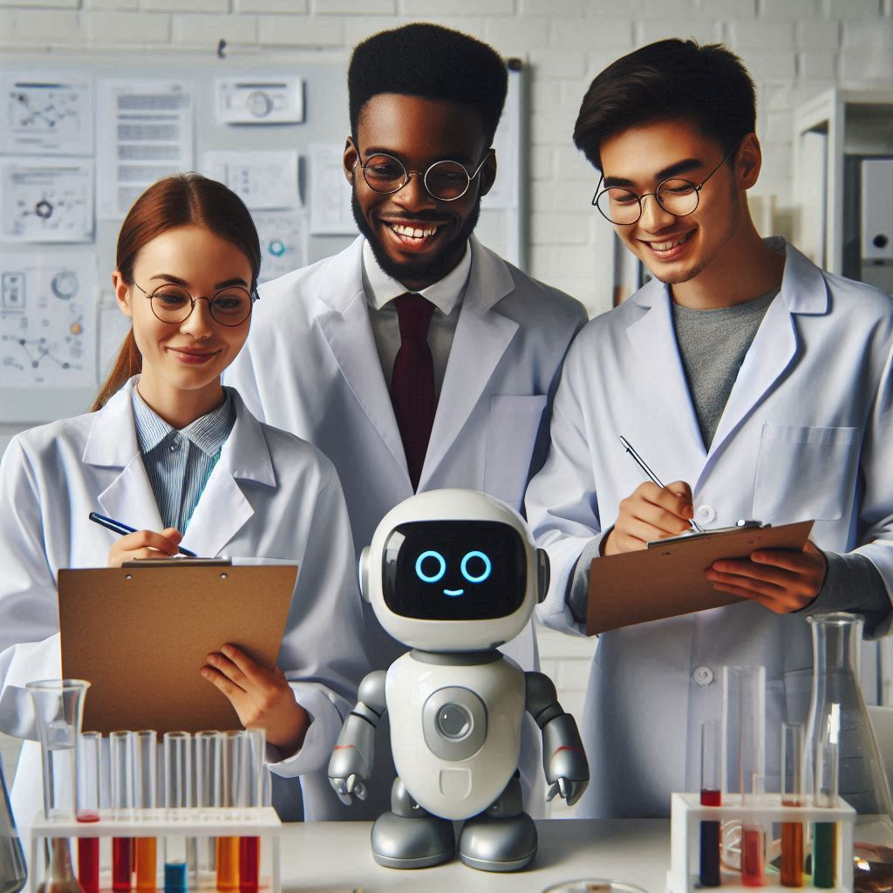
Generative AI for Researchers
Tools for researchers

Slide 2
Tools for researchers

Slide 3
Gen AI tools for researchers
heuristi.ca
perplexity AI
Explain Paper
Paperbrain
SCISPACE
Elicit
Quillbot
ideogram.ai
canva.com
claude.ai
semanticscholar.org
openread.academy
tavily.com
powerdrill.ai
maestra.ai Transcribe Interviews with AI
paperpal.com
jenni.ai
semihuman.ai

Slide 4
Academic Papers databases
semanticscholar.org
openread.academy
https://consensus.app/search/

Slide 5
Review Literature / AI Search Engines
Explain Paper
Perplexity AI
SCISPACE
Elicit
Paperbrain
tavily.com

Slide 6
Concept Mind Maps
heuristi.ca

Slide 7
Image Generation
ideogram.ai
canva.com
openart.ai

Slide 8
Alternatives to GPT
claude.ai

Slide 9
Review tools / writing assitance
Quillbot
jenni.ai
semihuman.ai
paperpal.com

Slide 10
Talk to your data
powerdrill.ai
www.chatdb.ai

Slide 11
ideation and decision-making
jeda.ai

Slide 12
Tools summary / comparison
https://guides.library.georgetown.edu/ai/tools
https://huit.harvard.edu/ai/tools

Slide 13
AI directories
https://www.stork.ai/
https://findmyaitool.com/

Slide 14
Video Generation Tools
Prompt : create a video of King Jaime, how he entered Valencia a thousand years ago, the celebrations and the king’s reception.
Tools
haiper.ai
ai.invideo.io
Filmora AI

Slide 15

Results

Slide 16
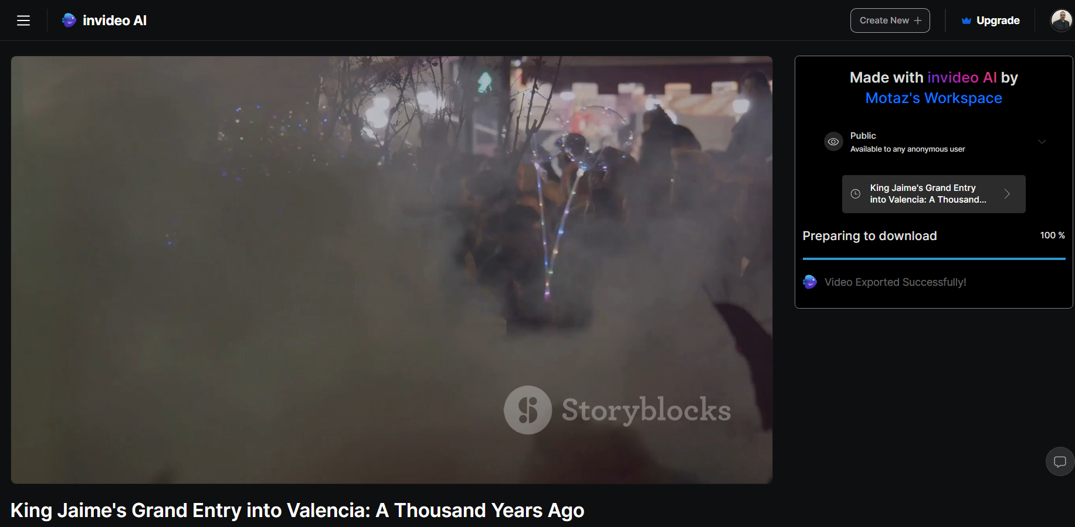
Results scene 1

Slide 17
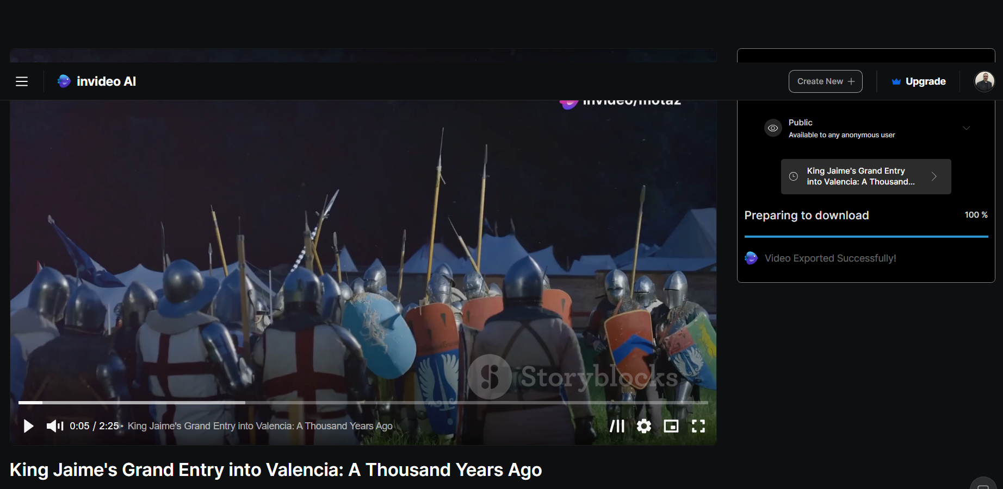
Results scene 2

Slide 18
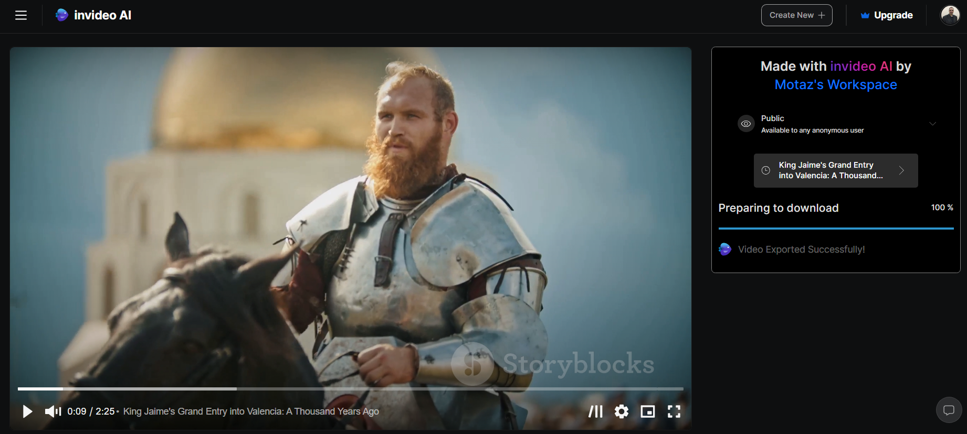
Results scene 3

Slide 19
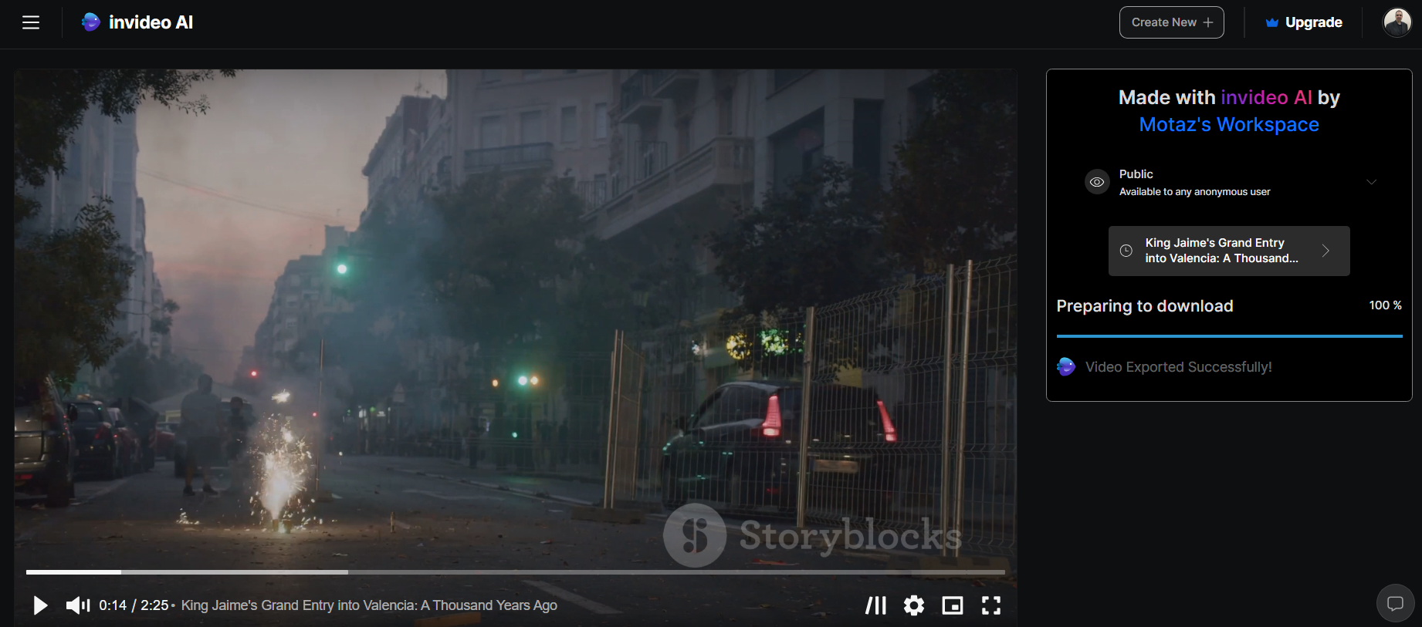
Results scene 4 😅😂

Slide 20
Best AI Video Generators for 2024
https://invideo.io/blog/best-ai-video-generators/
Invideo AI: Generating videos from text prompts
Descript: Script-based video editing
Runway: Exploring generative AI for text-based video creation
Fliki: Making videos tailored specifically for social media
Visla: Making scripts into videos
Opus Clip: Turning long-form videos into short-form content
Colossyan: Creating videos for workplace learning
DeepBrain AI: Turning text into videos
Hour One: Creating medium to short-form videos
Synthesia: Mixing in digital avatars

Slide 21
Image Generation
prompt: draw maps of Valencia city in the Roman era (BC 31 – AD 476). The map should include a river, a wall, gates, a cathedral, and a market.
Tools
Shutterstock: Best AI Art for Any Project
DALL-E 2: The Game-Changer
Hotpot: The Best Portrait Artist
NightCafe: A Community at Your Fingertips
Deep Dream Generator: The Best for Surrealism

Slide 22
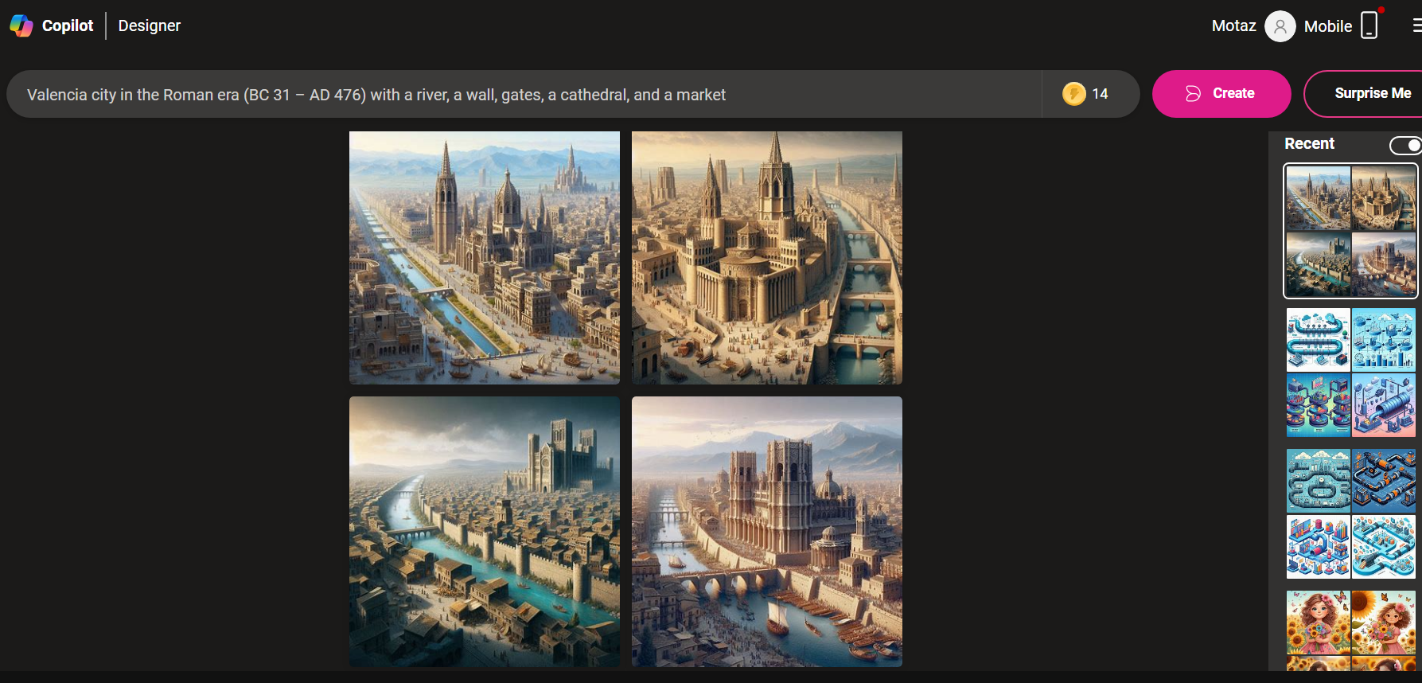
Image Generation

Slide 23
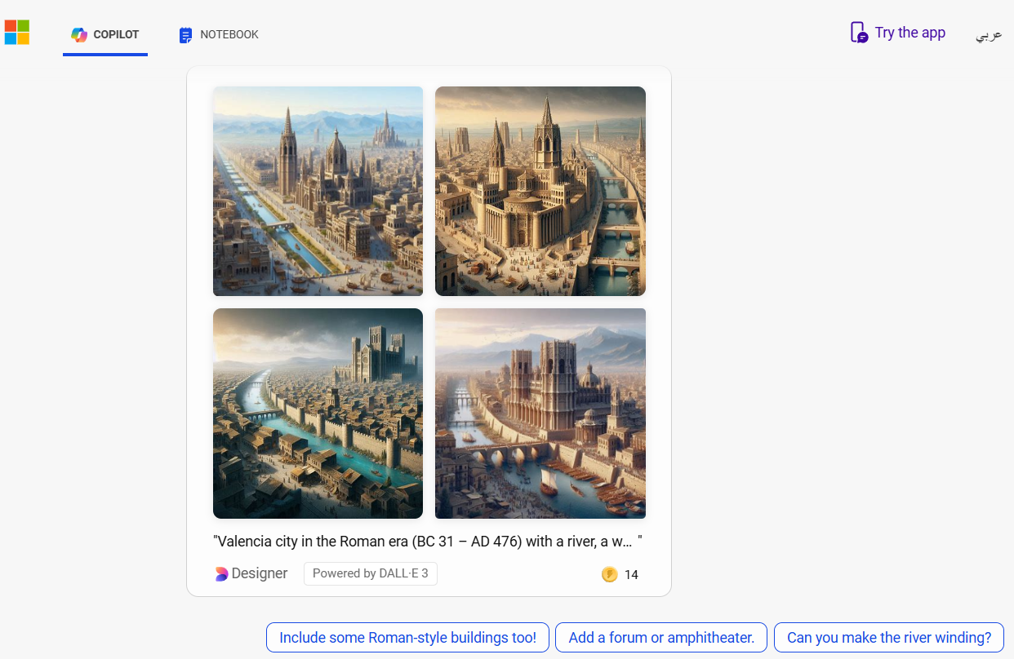

Slide 24
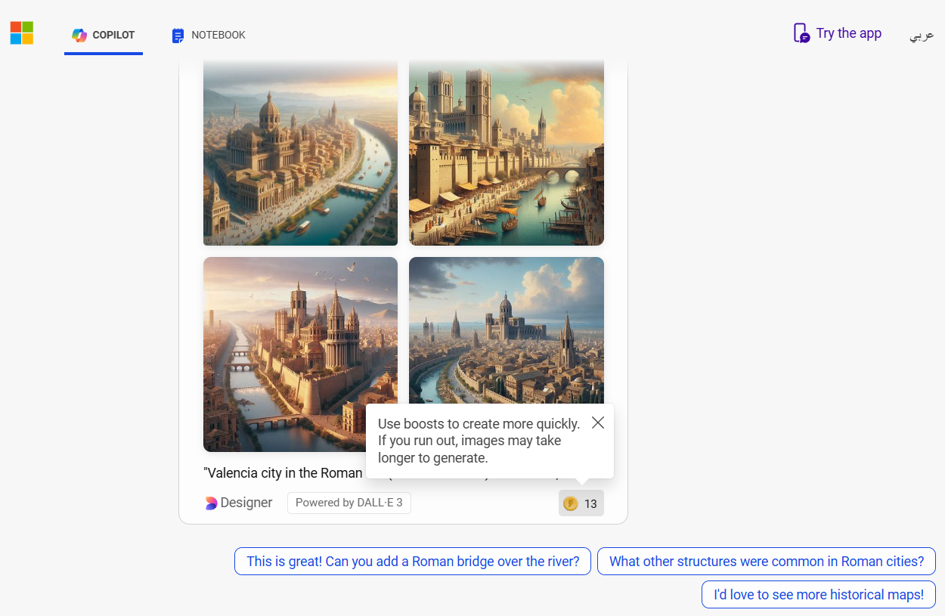

Slide 25
What other structures were common in Roman cities?
Certainly! In ancient Roman cities, several structures were common and played essential roles in shaping urban life. Let's explore some of them:
1. **Amphitheatres**: - The Romans loved entertainment, and amphitheatres were large stadiums where they could watch live events, including gladiator contests, animal hunts, and theatrical performances.
2. **Forum**: - The forum was a bustling market square at the heart of the town or city. It served as a hub for commerce, social gatherings, and political activities.
3. **Temples**: - Religion held great importance for the Romans. They worshipped various gods, and temples were dedicated to these deities. Temples featured impressive architecture and were central to religious ceremonies.
4. **Colosseum**: - The iconic Colosseum in Rome is perhaps the most famous amphitheatre. It hosted grand spectacles and could accommodate tens of thousands of spectators.
5. **Aqueducts**: - These engineering marvels transported water from distant sources to urban areas. Aqueducts ensured a reliable water supply for public baths, fountains, and households.
6. **Public Baths**: - Bath complexes were large structures with domes, columns, pools, and open spaces. Romans valued cleanliness and socializing at these communal bathing facilities.
These structures not only served practical purposes but also reflected the grandeur and innovation of Roman architecture. 🏛️✨⁵⁷
Source: Conversation with Copilot, 7/25/2024
(1) Roman Cities - A KS2 Guide to the Important Buildings - Imagining History. https://www.imagininghistory.co.uk/post/roman-cities-buildings.
(2) Durability, Power, and Imposing Public Edifices of Roman Architecture .... https://www.ancient-origins.net/ancient-places-europe/roman-architecture-0011303.
(3) Ancient Rome 101 | National Geographic. https://www.youtube.com/watch?v=GXoEpNjgKzg.
(4) Ancient Roman Architecture | Characteristics, Structures & Style. https://study.com/academy/lesson/ancient-roman-architecture-facts-style-characteristics.html.
(5) Roman Architecture - World History Encyclopedia. https://www.worldhistory.org/Roman_Architecture/.
(6) Roman architecture (article) | Ancient Rome | Khan Academy. https://www.khanacademy.org/humanities/ancient-art-civilizations/roman/x7e914f5b:beginner-guides-to-roman-architecture/a/roman-architecture.
(7) 3.2.1: An introduction to ancient Roman architecture. https://human.libretexts.org/Bookshelves/Art/SmartHistory_of_Art_2e/02%3A_SmartHistory_of_Art_II-_Ancient_Mediterranean/03%3A_Ancient_Rome_I/3.02%3A_Beginner_guides_to_Roman_architecture/3.2.01%3A_An_introduction_to_ancient_Roman_architecture.

Slide 26
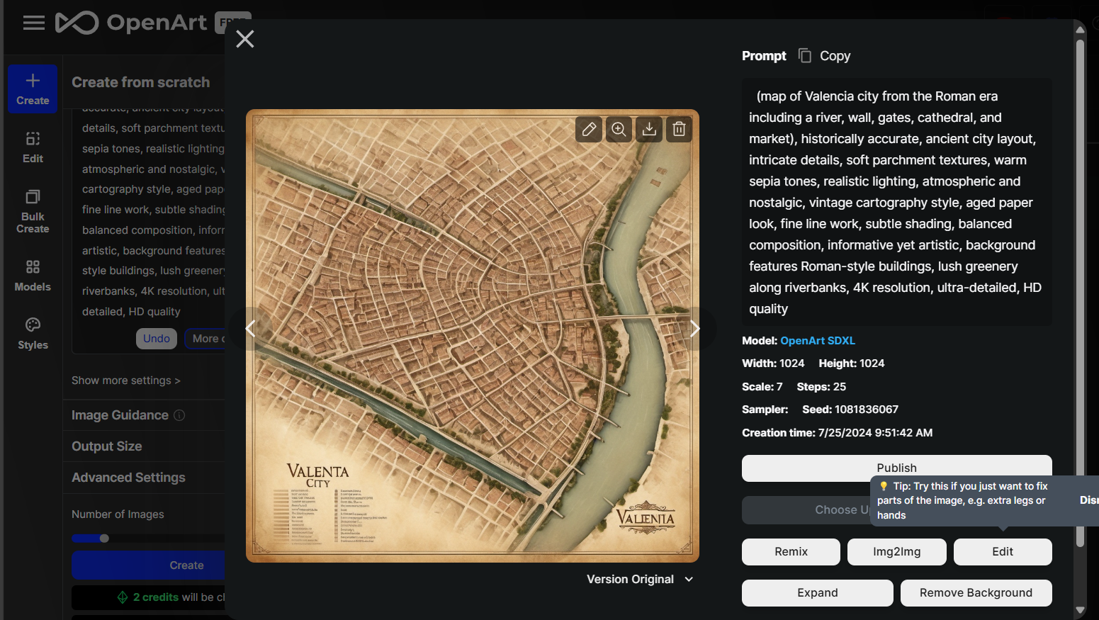
openart.ai

Slide 27
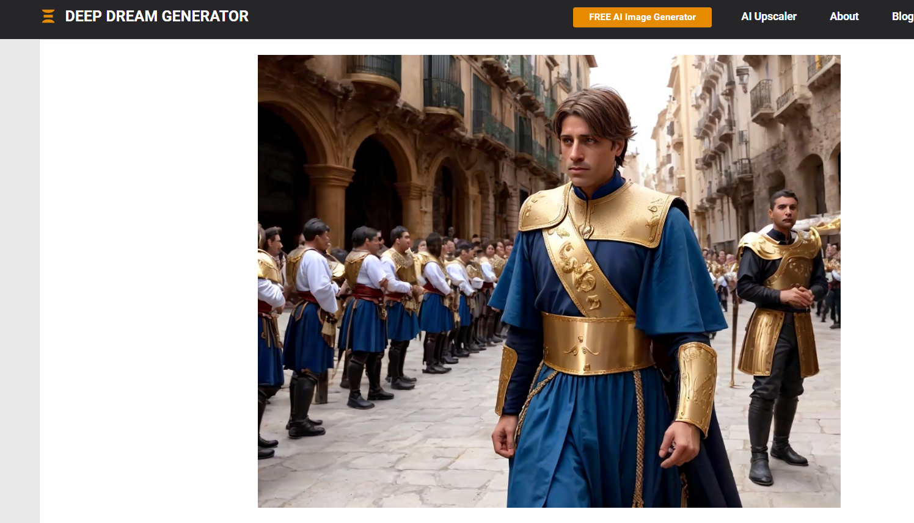

Slide 28
AI detector tools
https://ddiy.co/ai-image-detection-tools/
AI or Not aiornot.com
illuminarty.ai
https://huggingface.co/spaces/umm-maybe/AI-image-detector

Slide 29
Gen AI at academic research

Slide 30
Gen AI at academic research
Use AI responsibly
Use AI to help you brainstorm
Use AI to gather and analyze data
Use AI to help verify your findings and enhance transparency
Use AI to predict and then parse reviewer feedback

Slide 31
Use AI to gather and analyze data
“What is the best way to collect data on [insert topic]?
What is the best software to use for this?
Can you help get that data?
How do I build the code to get this data?
What is the best way to analyze this data?
If you were a skeptical reviewer, what would you also control for with this analysis?”

Slide 32
Use AI to help verify your findings and enhance transparency
Can you write summarized notations of this program or of the previous steps so that others can understand what I did here?
Can we reproduce these findings using a different statistical technique?
Can you generate a point-by-point summary diary of what I did in the previous month from this calendar?
Can you create a step-by-step representation of the workflow I used in this study?
Can you help generate an appendix of the parameters, tests, and configuration settings for this analysis?

Slide 33
Use AI to predict and then parse reviewer feedback
As a skeptical reviewer who is inclined to reject papers, what potential flaws in my paper do you see?
How can I minimize those flaws?
Once you receive reviewer feedback
Help me identify key points in this review, listing them from the easiest and quickest comments to address, up to the most challenging and time-consuming reviewer comments.

Slide 34
Best Practices
Always remember that AI recirculate ideas, and does not generate a novel ones
Always remember that AI is an enhancer, not a replacement
Verify results (always)
Stay informed about the developments in the field

Slide 35
FAQs

Slide 36
Can I use generative AI to write and/or develop research papers?
Academic publishers / universities have a range of policies on the use of AI in research papers.
In some cases, publishers / universities may prohibit the use of AI for certain aspects of paper development.
You should review the specific policies of the target publisher / university to determine what is permitted.

Slide 37
Sampling of Publisher’s policies available online
Elsevier https://www.elsevier.com/about/policies-and-standards/publishing-ethics#4-duties-of-authors
JAMA and the JAMA Network https://jamanetwork.com/journals/jama/fullarticle/2801170
PLOS ONE https://journals.plos.org/plosone/s/ethical-publishing-practice#loc-artificial-intelligence-tools-and-technologies
Sage https://us.sagepub.com/en-us/nam/chatgpt-and-generative-ai-0
Springer Nature https://www.nature.com/nature-portfolio/editorial-policies/ai#:~:text=As%20publishers%2C%20we%20strictly%20follow,permit%20its%20use%20for%20publication.
Science https://www.science.org/content/page/science-journals-editorial-policies
Wiley https://authorservices.wiley.com/ethics-guidelines/index.html

Slide 38
A sample of univercity policies available online
https://communitystandards.stanford.edu/generative-ai-policy-guidance
https://guides.library.georgetown.edu/ai/ethics
https://provost.columbia.edu/content/office-senior-vice-provost/ai-policy
https://huit.harvard.edu/ai/guidelines
https://about.open.ac.uk/policies-and-reports/policies-and-statements/gen-ai/generative-ai-students
https://honorcode.nd.edu/generative-ai-policy-for-students-august-2023/
https://teaching.iu.edu/resources/generative-ai/policies.html

Slide 39
How should AI-generated content be cited in research papers?
Guidance will likely develop as AI systems evolve, but some leading style guides have offered recommendations:
APA Style
The Chicago Manual of Style
MLA Style Guide

Slide 40
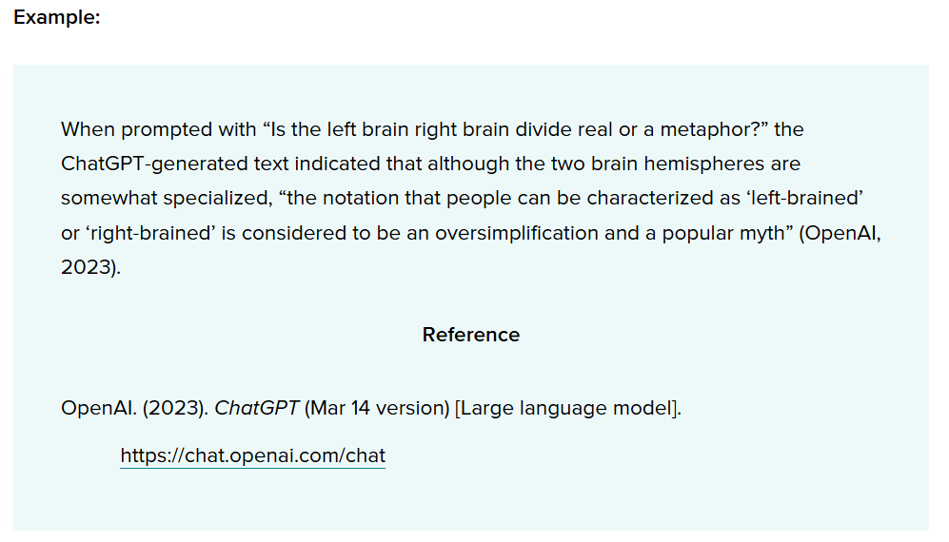
APA Citation example

Slide 41
APA style
Author: The author of the model is OpenAI.
Date: The date is the year of the version you used. Following the template in Section 10.10, you need to include only the year, not the exact date. The version number provides the specific date information a reader might need.
Title: The name of the model is “ChatGPT,” so that serves as the title and is italicized in your reference, as shown in the template. Although OpenAI labels unique iterations (i.e., ChatGPT-3, ChatGPT-4), they are using “ChatGPT” as the general name of the model, with updates identified with version numbers.
The version number is included after the title in parentheses. The format for the version number in ChatGPT references includes the date because that is how OpenAI is labeling the versions. Different large language models or software might use different version numbering; use the version number in the format the author or publisher provides, which may be a numbering system (e.g., Version 2.0) or other methods.

Slide 42
Should I disclose the use of generative AI in a research paper?
Yes. Most academic publishers require researchers using AI tools to document this use in the methods or acknowledgements sections of their papers.
You should review the specific guidelines of the target publisher to determine what is required.

Slide 43
Can I use AI in writing grant applications?
You should review the specific policies of potential funders to determine if the use of AI is permitted.
The National Institutes of Health (NIH) advises caution: “If you use an AI tool to help write your application, you also do so at your own risk,” as these tools may inadvertently introduce issues associated with research misconduct, such as plagiarism or fabrication.

Slide 44
Can I use AI in the peer review process?
Many funders have not yet published policies on the use of AI in the peer review process. However, the National Institutes of Health (NIH) has prohibited such use “for analyzing and formulating peer review critiques for grant applications and R&D contract proposals.” You should carefully review the specific policies of funders to determine their stance on the use of AI

Slide 45
Are there AI safety concerns or potential risks I should be aware of?
Yes. Some of the primary safety issues and risks include the following:
Bias and discrimination: The potential for AI systems to exhibit unfair or discriminatory behavior.
Misinformation, impersonation, and manipulation: The risk of AI systems disseminating false or misleading information, or being used to deceive or manipulate individuals.
Research and IP compliance: The necessity for AI systems to adhere to legal and ethical guidelines when utilizing proprietary information or conducting research.
Security vulnerabilities: The susceptibility of AI systems to hacking or unauthorized access.
Unpredictability: The difficulty in predicting the behavior or outcomes of AI systems.
Overreliance: The risk of relying excessively on AI systems without considering their limitations or potential errors.

Slide 46
Initial guidelines for the use of Generative AI tools
Protect confidential data
You should not enter data classified as confidential into publicly-available Generative AI tools
Review content before publication
AI-generated content can be inaccurate, misleading, or entirely fabricated (sometimes called “hallucinations”) or may contain copyrighted material. You are responsible for any content that you publish that includes AI-generated material.
Adhere to existing academic policy
Review your School’s student and faculty handbooks and policies.
We expect that Schools will be developing and updating their policies as we better understand the implications of using Generative AI tools.
In the meantime, faculty should be clear with students they’re teaching and advising about their policies on permitted uses, if any, of Generative AI in classes and on academic work.
Students are also encouraged to ask their instructors for clarification about these policies as needed.

Slide 47
Can professors detect AI writing?
Yes, they can detect AI writing in several ways. Software programs like Turnitin’s AI Writing Detection can analyze text for signs of AI generation.
Experienced professors who have read many student papers can often develop a feeling about whether a paper was written by a human or machine.

Slide 48
How can AI detect AI contents?!
Feature Analysis: AI-generated content often has distinct statistical and linguistic patterns. Algorithms can analyze features like sentence structure, word frequency, and syntax to identify these patterns.
Stylometry: Stylometry involves analyzing writing style. AI models can compare the stylistic features of a text with known human and AI-generated samples to detect discrepancies.
Language Models: Advanced language models, like GPT-4, can be trained to recognize AI-generated content by exposing them to a large dataset of both human-written and AI-generated text. They learn to identify subtle differences.
Metadata Analysis: AI-generated content might contain metadata or formatting characteristics that differ from human-generated content. Analyzing these metadata can help in detection.

Slide 49
How can AI detect AI contents?!
Cross-referencing: AI can cross-reference text with a database of known AI-generated content to check for similarities or repetitions.
Content Inconsistencies: AI-generated content might lack the depth, coherence, or factual accuracy seen in human-written content. Detecting inconsistencies or shallow content can be a red flag.
Watermarking: Some AI systems can embed invisible watermarks in the content they generate, which can later be detected to verify the source.

Slide 50
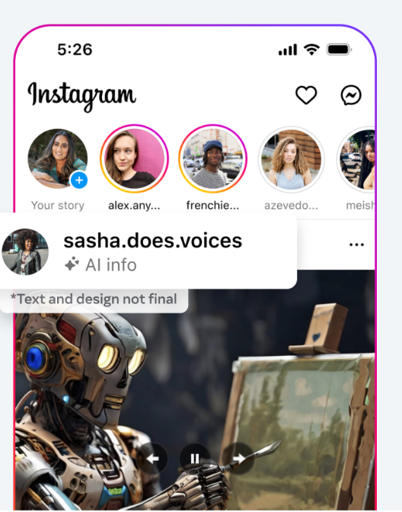
meta data and water marks

Slide 51
What if your content is falsely classified as AI-generated?!
Understand the Criteria: Understand the specific criteria and methods used by the AI tool that classified your content. This can help you identify why your content might have been flagged.
Provide Proof of Authorship
Drafting History: Share the drafting history or version history of the document if it's available. Many writing tools and platforms keep track of revisions and can show the progression of your work.
Supporting Documents: Provide notes, outlines, or research materials that show your thought process and work leading up to the final content.

Slide 52
What if your content is falsely classified as AI-generated?!
Request a Review
Manual Review: Request a manual review by a human expert. Most detection tools and services offer this option for disputed cases.
Detailed Explanation: Provide a detailed explanation of your writing process, including any unique stylistic choices or sources you used.
Modify Your Content
Edit for Clarity: Make edits to your content to reduce the likelihood of it being flagged. This could involve varying sentence structure, enhancing coherence, and adding personal touches that highlight human authorship.
Avoid Common Patterns: Be aware of and avoid writing patterns that AI models commonly produce.

Slide 53
What if your content is falsely classified as AI-generated?!
Communicate with the Platform
Contact Support: Reach out to the support team of the platform or service that classified your content. Provide all relevant information and request a re-evaluation.
Feedback Loop: If possible, offer feedback to improve the AI detection tool. This can help reduce false positives for you and other users in the future
Legal and Academic Considerations
Institutional Guidelines: If the content is for academic or professional purposes, follow the guidelines provided by your institution or employer for such disputes.
Legal Advice: In rare cases where false classification has significant repercussions, consider seeking legal advice.

Slide 54
What if your content is falsely classified as AI-generated?!
Preventive procedure
Transparency: Be transparent about your writing process from the start, especially if your content will be subject to scrutiny.
Documentation: Keep thorough documentation of your work process, including drafts, sources, and correspondence related to the content creation.

Slide 55
To minimize false positives in your content
Don’t overuse LLMs: Overusing large language models (LLMs) can have unintended consequences.
Diverse Vocabulary: Use a wide range of vocabulary and avoid overusing specific terms associated with AI-generated content. This diversity helps differentiate your writing.
Human-Like Patterns: Emulate natural writing patterns. AI-generated text often lacks the nuances and imperfections found in human writing. Inject personality and authenticity into your content.
Avoid Templates: Steer clear of common templates or boilerplate phrases. AI models may recognize these patterns and trigger false positives.
Proofread and Revise: Carefully review your work. Look for unintentional similarities to AI-generated text. Make minor adjustments to reduce false positives.

Slide 56


Q&A

